Slide 1
Applications of Blockchains
Blockchains & Cryptocurrencies
Instructors: Matthew Green & Abhishek Jain

Slide 2
What can we build on top of Blockchains?

Slide 3
Why Applications from Blockchains?
Decentralization: Many applications easy to realize with a central trusted authority. Blockchains can often help in removing central trust

Slide 4
Applications
Timestamping
Token tracking
Public randomness
Prediction markets
Fair protocols: Multiparty lotteries, MPC
One-time Programs
Non-Interactive Zero Knowledge
…

Slide 5
Today’s Agenda
Fair Protocols using Blockchains

Slide 6
How to Use Bitcoin to Design Fair Protocols
Cryptocurrencies
Iddo Bentov, Ranjit Kumaresan
CRYPTO 2014
Slides based on Ranjit’s talk

Slide 7
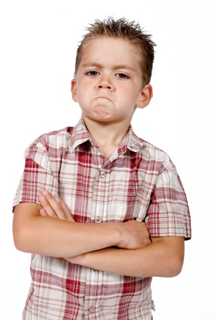

Secure Computation
x
y
f (x,y)
f (x,y)
Most general problem in cryptography
Feasibility results [Yao86,GMW87,…]
Moving fast from theory to practice

Slide 8



Secure Computation
x
y
≈
x
y
f (x,y)
f (x,y)
f (x,y)
f (x,y)
Ideally…
Protocol for secure computation emulates a trusted party
Privacy
Correctness
Fairness

Slide 9
Fairness in Secure Computation
f (x,y)
2-party fair coin tossing impossible [Cle86]
Fair secure computation possible only in restricted settings
For restricted class of functions [GHKL08,Ash14]
If majority of parties are honest [BGW88,RB89]

Slide 10

Fair Exchange
[Rab81,BGMR85,ASW97,ASW98,BN00,….]
E.g., contract signing, digital media
Special case of secure computation
Authenticity & fairness
Contract signing:
Two parties want to sign a contract
Neither wants to commit first
The other signer could be malicious…

Slide 11
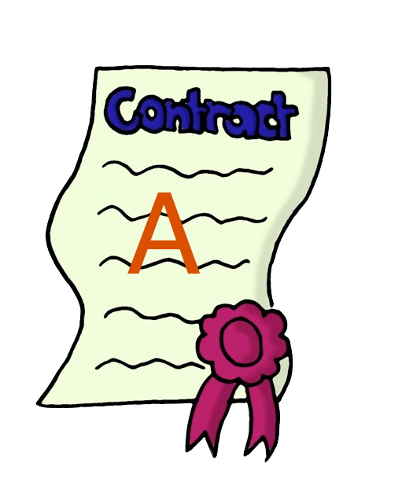

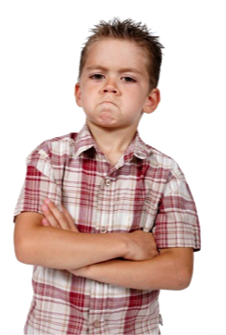
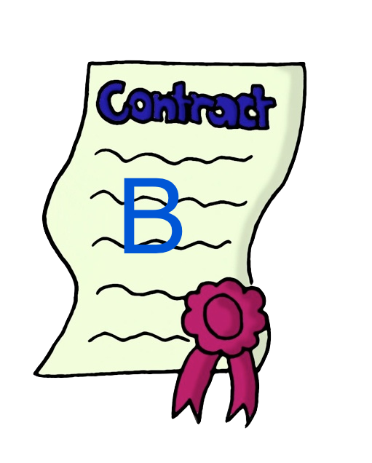
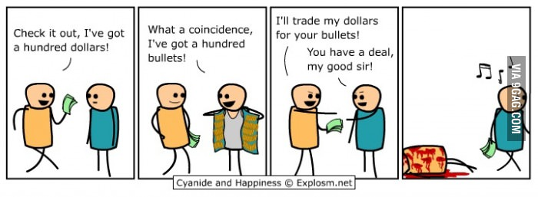
Fair Exchange
[Rab81,BGMR85,ASW97,ASW98,BN00,….]
Fair exchange is
impossible
[Cle86,PG99,BN00]

Slide 12
Workarounds I
Gradual release mechanisms [BG89,GL91,BN00,GJ02,GP03,Pin03,GMPY06,…]
Partial fairness [MNS09,GK10,BOO10,BLOO11]
Control adversary’s advantage in learning the output first
Requires lots of rounds

Slide 13
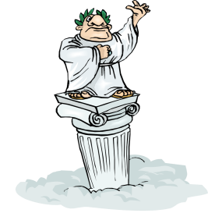
Workarounds II
Optimistic model [Rab81,BGMR85,ASW97,GJM99,Mic03,DR04,KL10…]
Trusted arbiter restores fairness
Contacted only when required
Requires trusting a third party
Potentially need to pay “subscription fee” to arbiter
f (x,y)
Bad guys get away with cheating

Slide 14
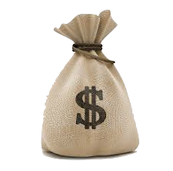
Workarounds III
Penalty model [ASW00,MS01,CLM07,Lin08,KL10]
Deviating party pays monetary penalty to honest party
lose money!
Bad guys get away with cheating
“Secure computation with penalties”

Slide 15
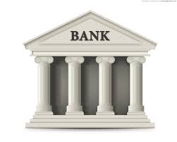

Penalty Model
“Legally enforceable fairness” [Lin08]
Requires central trusted bank
“Usable optimistic exchange” [ASW00,MS01,CLM07,KL10]
Requires trusted arbiter (+ e-cash)
Ideally…
Decentralized system; no trusted third party
Widely adopted

Slide 16

Secure computation with penalties
Can Bitcoin replace a trusted bank/arbiter?
x
y
f (x,y)
f (x,y)

Slide 17
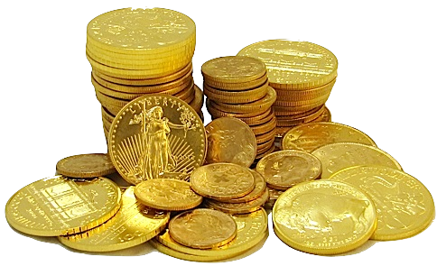
Defining Coins
Atomic entities
Indistinguishable from one another
(Unique) owner possesses given coin
Ownership changes upon transfer
Notation: coins(x)
coins(x) + coins(y) = coins(x + y)
coins(x) - coins(y) = coins(x - y)

Slide 18
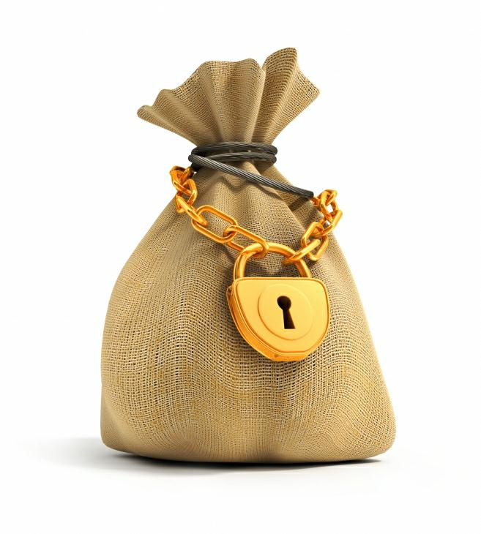
Claim-or-Refund Functionality
F_{CR}
Accepts from “sender”
Deposit: coins(x)
Time bound: τ
Circuit: ϕ
Designated “receiver” can claim this deposit
Produce witness T that satisfies ϕ
Within time τ
If claimed, then witness revealed to ALL parties
Else coins(x) returned to sender
T
ϕ, τ
Efficient realization via Bitcoin scripts

Slide 19
Strategy
Reduce fair secure computation to fair reconstruction
Hybrid model with functionality F’
Computes output of f, say z
Secret share z into n additive shares sh₁,…,sh_{n}
Computes commitments on shares
c_{i} = com(sh_{i}; w_{i}) for every i
Delivers output: ({c₁,…,c_{n}}, T_{i} = (sh_{i}, w_{i})) to party P_{i}

Slide 20
Two Party Fair Reconstruction
denotes
P₂ must reveal witness T = (sh,w) within time τ to claim coins(q) from P₁
Secure computation with penalties
Honest parties never have to lose coins
If a party aborts after learning the output then every honest party is compensated
“Abort” Attack
P₂ aborts without making its deposit but claims P₁’s deposit
Honest P₁ loses money (although it learns output)

Slide 21
Two Party Fair Reconstruction
denotes
P₂ must reveal witness T = (sh,w) within time τ to claim coins(q) from P₁
Secure computation with penalties
Honest parties never have to lose coins
If a party aborts after learning the output then every honest party is compensated
Deposits made top to bottom
Claims made in reverse direction
If P₁ claims the 2nd deposit, then P₂ can always claim the 1st

Slide 22
Three Party Fair Reconstruction
denotes
P₂ must reveal witness T = (sh,w) within time τ to claim coins(q) from P₁
Secure computation with penalties
Honest parties never have to lose coins
If a party aborts after learning the output then every honest party is compensated
Malicious Coalitions
Coalition of P₁ and P₂ obtain T₃ from P₃
Then P₂ does not claim 1st transaction
P₁, P₂ learn output but P₃ is not compensated

Slide 23
Three Party Fair Reconstruction
denotes
P₂ must reveal witness T = (sh,w) within time τ to claim coins(q) from P₁
Secure computation with penalties
Honest parties never have to lose coins
If a party aborts after learning the output then every honest party is compensated
P₂ claims twice the penalty amount
Sufficient to deal with malicious coalition of P₁, P₃

Slide 24
Multiparty “Ladder” Protocol
Order of deposits/claims
Roof deposits made simultaneously
Ladder deposits made one after the other
Ladder claims in reverse
Roof claims at the end
Roof
High-level Intuition
At the end of ladder claims, all parties except P_{n} have “evened out”
If P_{n} does not make roof claims then honest parties get coins(q) via roof refunds
Else P_{n} “evens out”
Ladder

Slide 25
Fair Multiparty Computation from Public Bulletin Boards
Arka Rai Choudhuri - Matthew Green - Abhishek Jain - Gabriel Kaptchuk - Ian Miers
ACM CCS’17
Slides based on Gabe’s talk

Slide 26
Public Bulletin Boards

Slide 27
Public Bulletin Boards
Public: Messages are visible to all parties
Available: Messages are permanently available (cannot be modified or deleted)
Unforgeable: No adversary can produce a “valid looking” state of the bulletin board which is different from the real state. (Can think of the bulletin board providing an unforgeable signature for every post)

Slide 28
Why Bulletin Boards?
Existing technologies can be used as bulletin boards
I. Proof-of-Stake based Blockchains
II. Google Certificate Transparency
Blockchain records are public and available.
Proof-of-stake based blockchains satisfy unforgeability [Goyal-Goyal’17]
Can be used as an append-only public log
Certificates present in the log can be verified by root signature.
Notes:
Add “CT”

Slide 29


x₁
x₂
How to Decrypt?

Slide 30
Want: Fair Decryption
Either both the parties should be able to decrypt, or no one
Put differently, either both parties can learn decryption key or no one can
Idea: Decryption key: = (a release token RT, and bulletin board’s signature on RT)
But standard encryption schemes do not have such special keys!
Notes:
Add “CT”

Slide 31
Want: “Conditional Decryption”
Want: Ciphertexts that can only be decrypted if a certain action was implemented
Put differently, decryption should only be possible if a statement is true
Problem: Regular encryption/decryption keys are random strings (without such structure)

Slide 32
Witness Encryption [Garg-Gentry-Sahai-Waters’13]
Notes:
CITATION [BCP14]

Slide 33
Witness Encryption [Garg-Gentry-Sahai-Waters’13]
Security: If x is “false”, then Enc(m,x) is indistinguishable from Enc(m,x’)

Slide 34
Extractable Witness Encryption [Goldwasser-Kalai-Popa-Vaikuntanathan-Zeldovich’13]
(Informal) Security: Enc(m,x) is indistinguishable from Enc(m,x’) even for “true” x if no efficient adversary can find a witness for x

Slide 35
(Extractable) Witness Encryption
Candidate constructions known [Garg-Gentry-Sahai-Waters’13, Gentry-Lewko-Waters’14]
Open problem: Constructing WE from standard crytpographic assumptions
Notes:
Add “CT”

Slide 36
Back to Fair MPC
Idea: Let’s use Witness Encryption (WE) to encrypt the output
After the initial (unfair) MPC, anyone can post a release token RT to the bulletin board. Then RT, together with signature of the bulletin board can be a “witness” for decryption
Let’s suppose that RT is a public value
Notes:
Add “CT”

Slide 37

(RT, sig)
x₂
x₁
x₃
RT
x₄
= WE(y, x := RT was posted on bulletin board)

Slide 38
Problem
What if adversary aborts in the initial unfair MPC so that only it learns the WE ciphertext (but not the honest parties)
Now, even if adversary posts RT on bulletin board, the honest parties get the witness but not the WE ciphertext!
Notes:
Add “CT”

Slide 39
Solution
Use a private release token RT
Consider two party case (for simplicity):
RT := (RT₁, RT₂) where RT₁ is chosen by P₁ and RT₂ is chosen by P₂
After initial MPC, parties exchange RT₁ and RT₂ with each other
Now, if adversary aborts in the initial MPC, RT exchange phase will not happen, so adversary cannot learn the output
If adversary aborts in the RT exchange phase, that’s ok. In order to recover output, it must post RT on bulletin board, which makes it public.
Notes:
Add “CT”

Slide 40
Security
Think: Can we base security on Witness Encryption?
Problem: Statement is always true (signatures on RT “exist”, just finding them without posting RT on bulletin board is “hard”)
Therefore, need Extractable Witness Encryption for security (can be avoided in some special cases)
Notes:
Add “CT”

Slide 41
A more efficient solution
Emulate Witness encryption using Trusted Hardware, e.g., Intel SGX
In this case, an efficient solution can be obtained if we start from an efficient (unfair) MPC

Slide 42

Trusted Hardware?!?
But Gabe, if you are using Trusted Hardware, isn’t all of this trivial? Trusted Hardware solves all security problems!

Slide 43
Trusted Hardware?!?
Trusted Hardware alone cannot guarantee fairness [Pass-Shi-Tramer’17]

Slide 44
Open Questions
Can we base security on regular witness encryption?
Can we base security on standard assumptions?

